Slide 1
WELCOME
01
ABOUT ME
3D drawings
Pooja daksh

Slide 2
3d drawings
03
sketchup
Pooja daksh

Slide 3
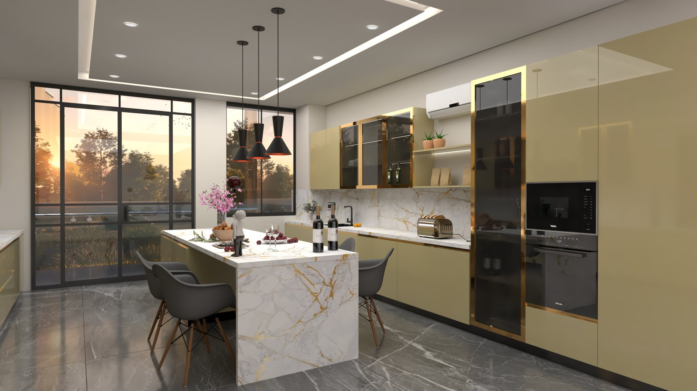
Kitchen 3d
03
sketchup
Pooja daksh

Slide 4
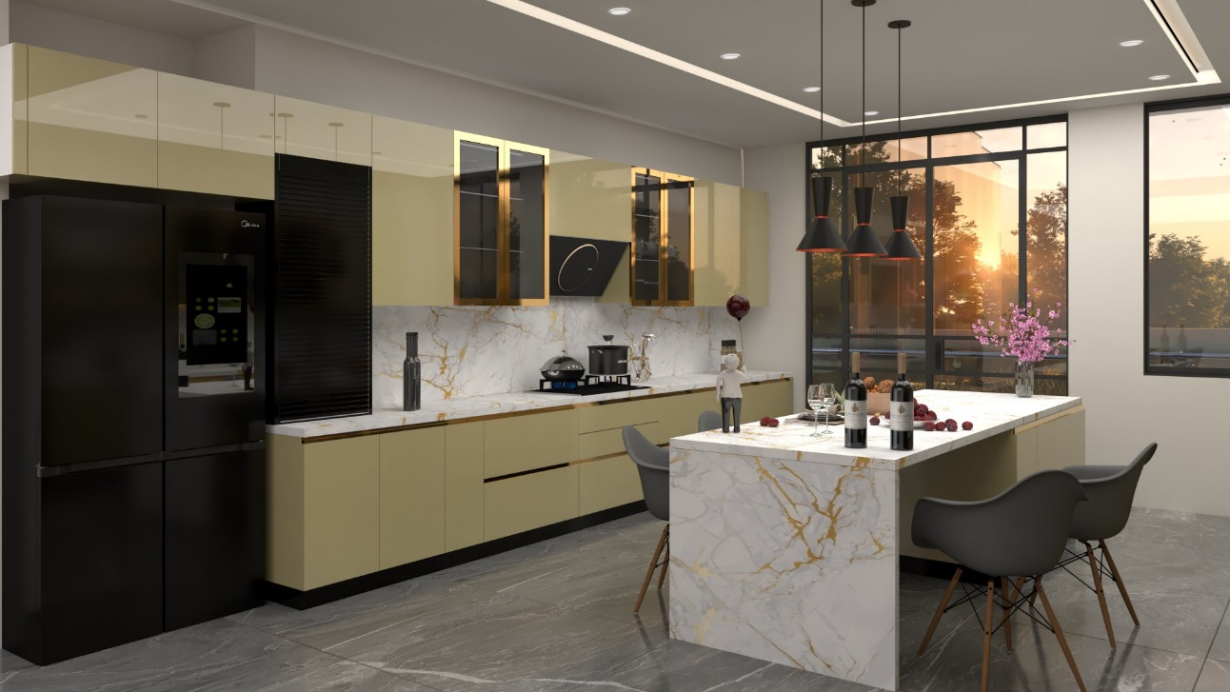
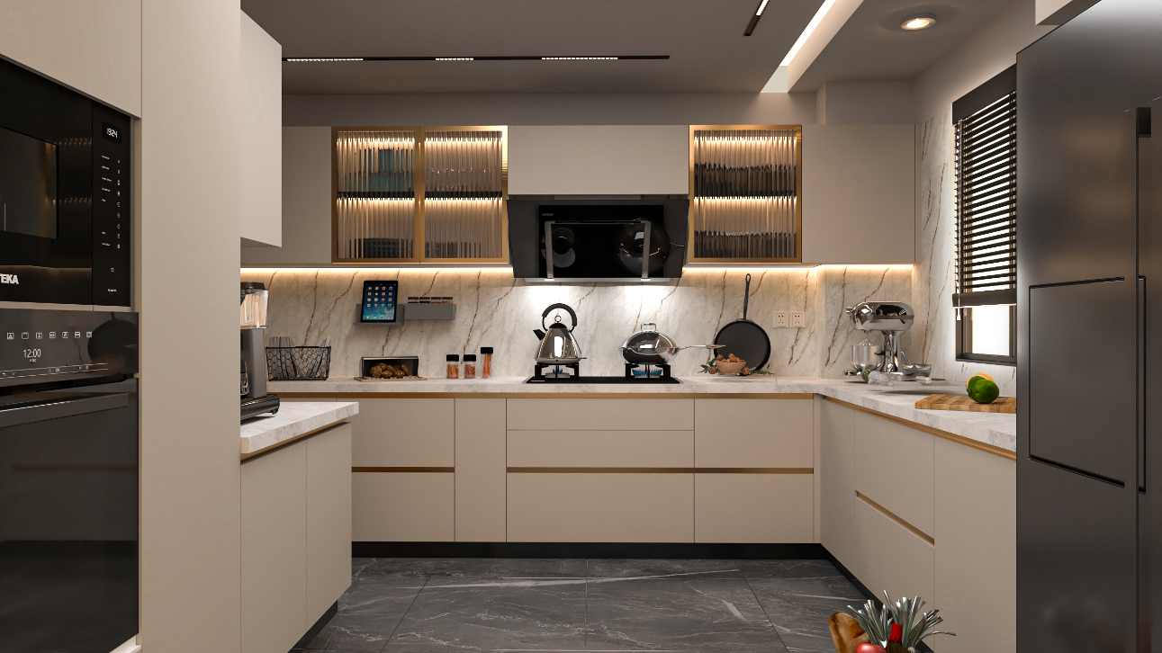

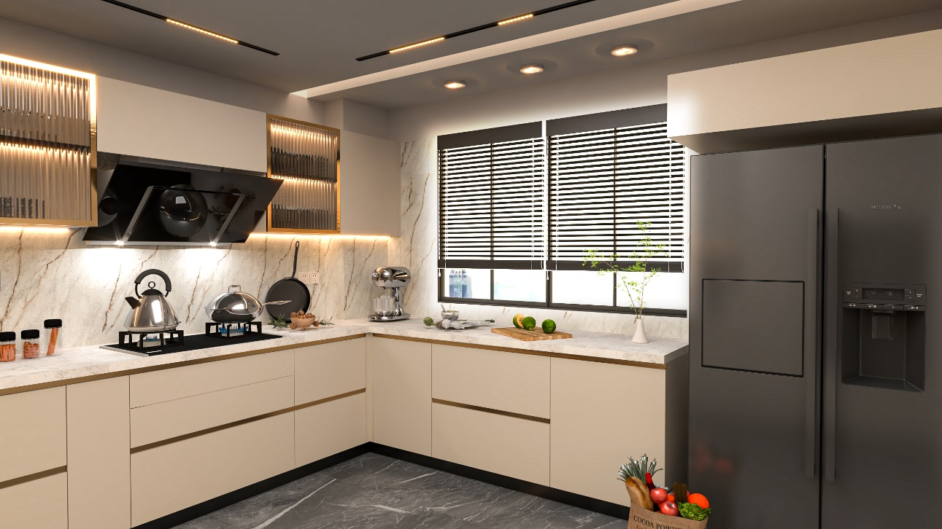
03
Pooja daksh

Slide 5
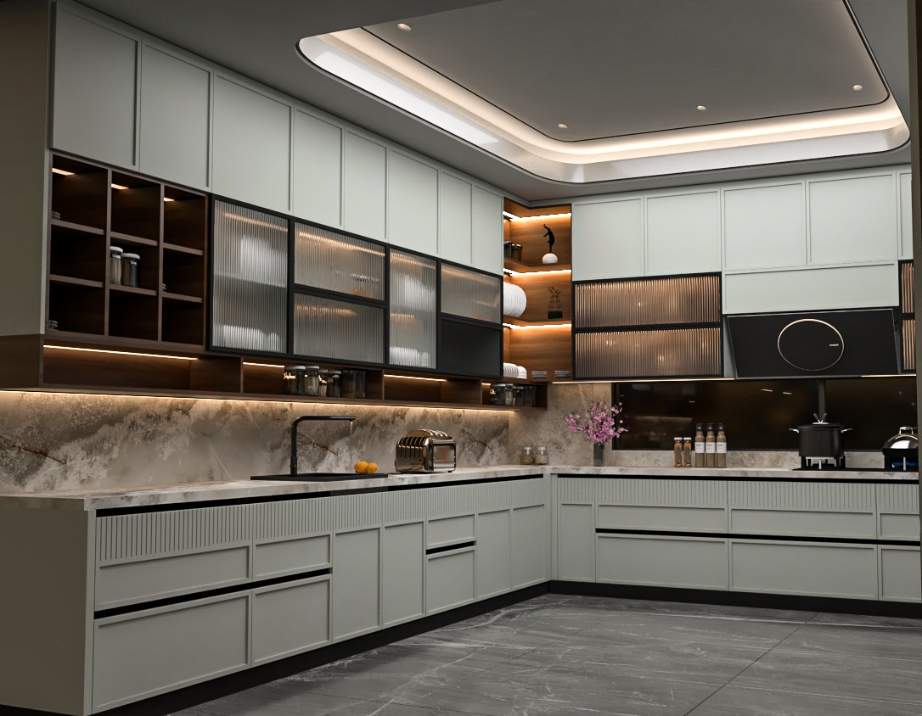
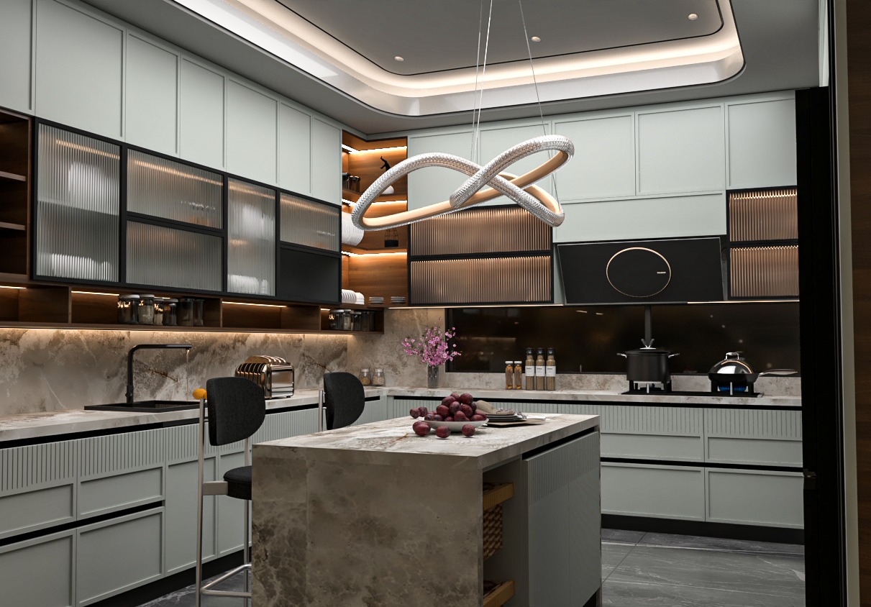
03
Pooja daksh

Slide 6
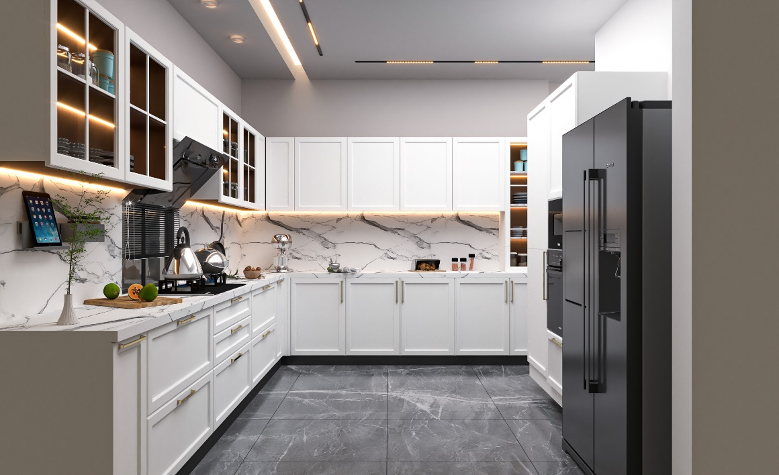
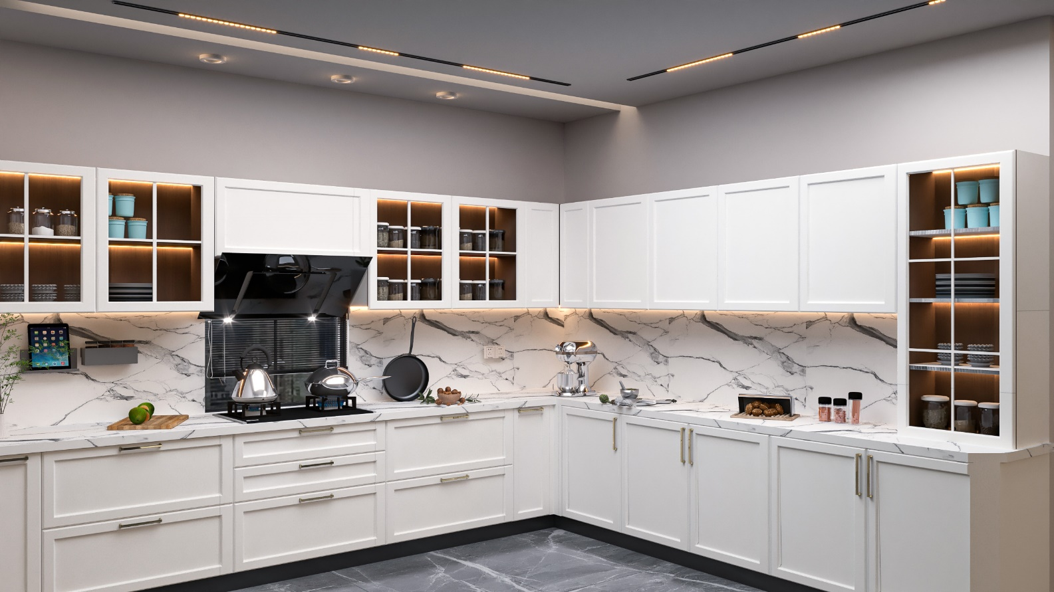
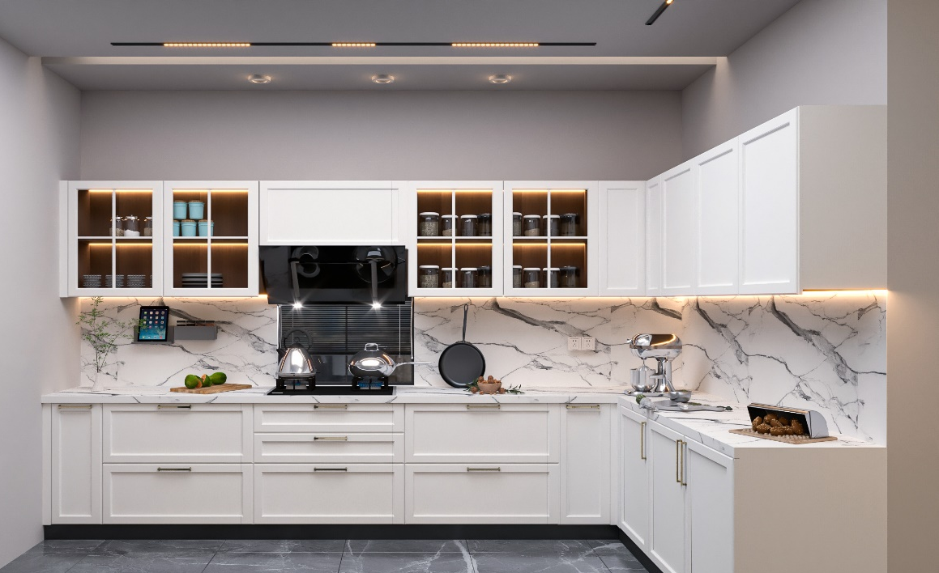
03
Pooja daksh

Slide 7
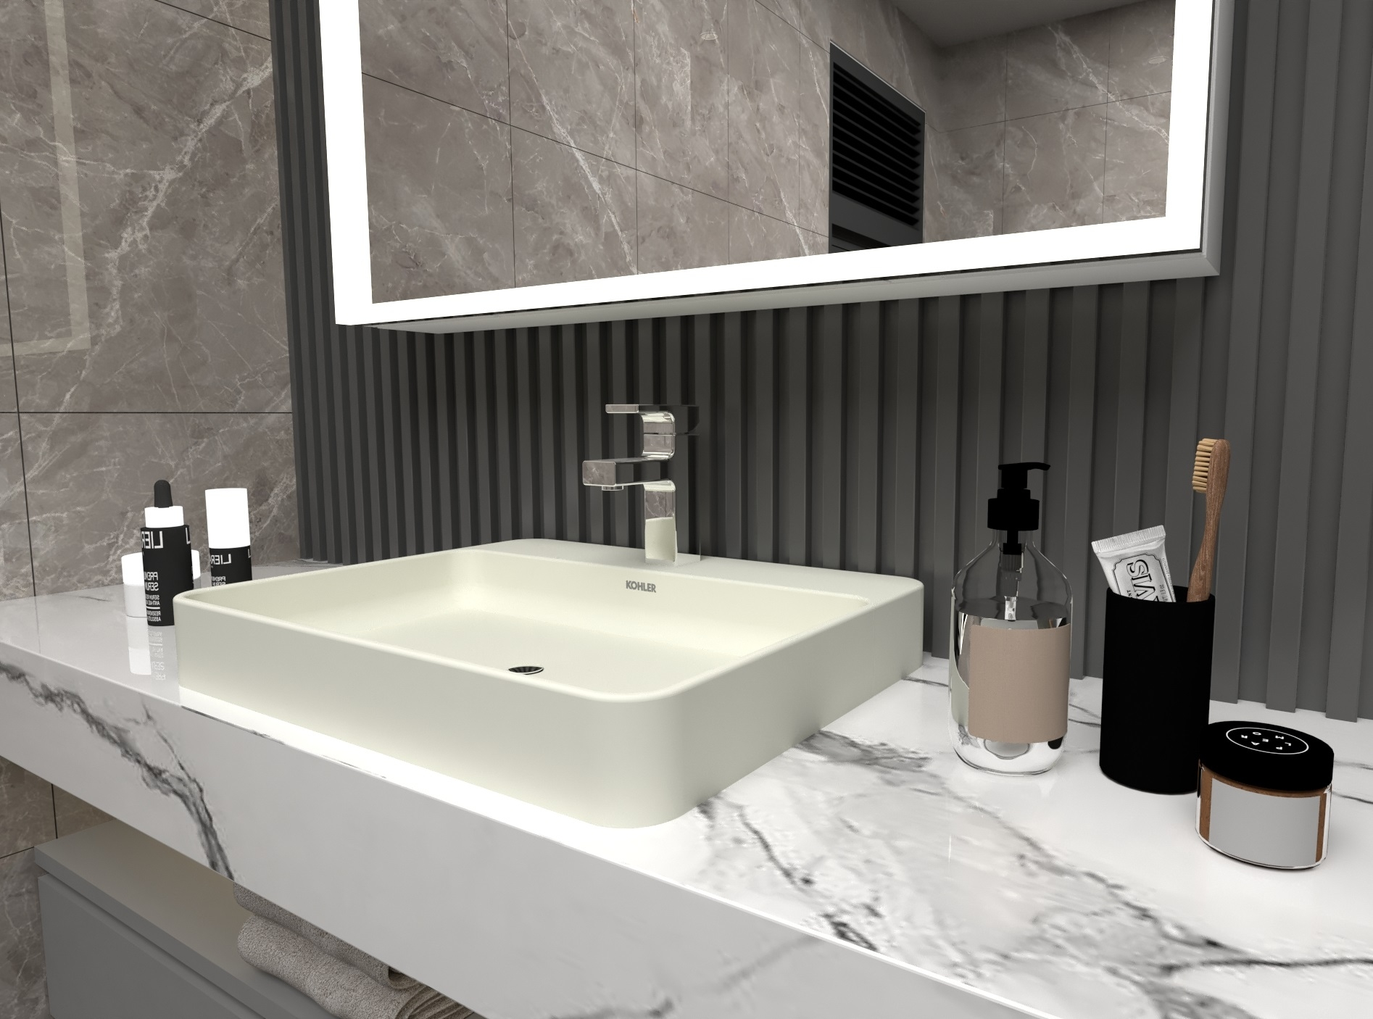
Vanities and wardrobes
03
Pooja daksh
sketchup
Pooja daksh

Slide 8
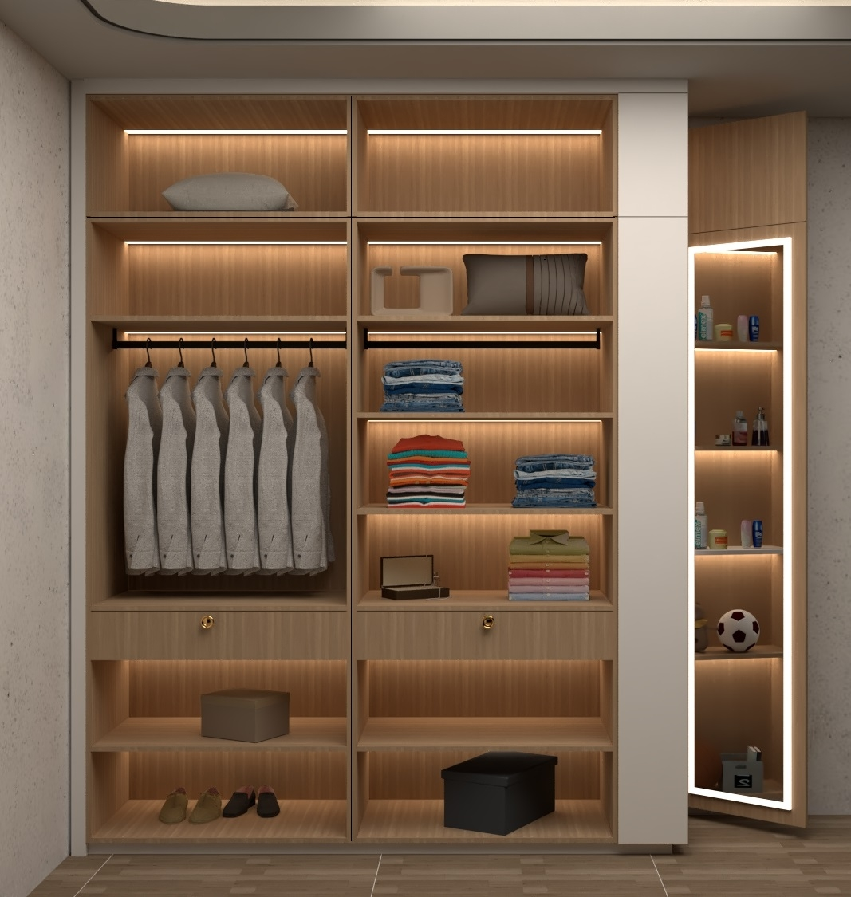
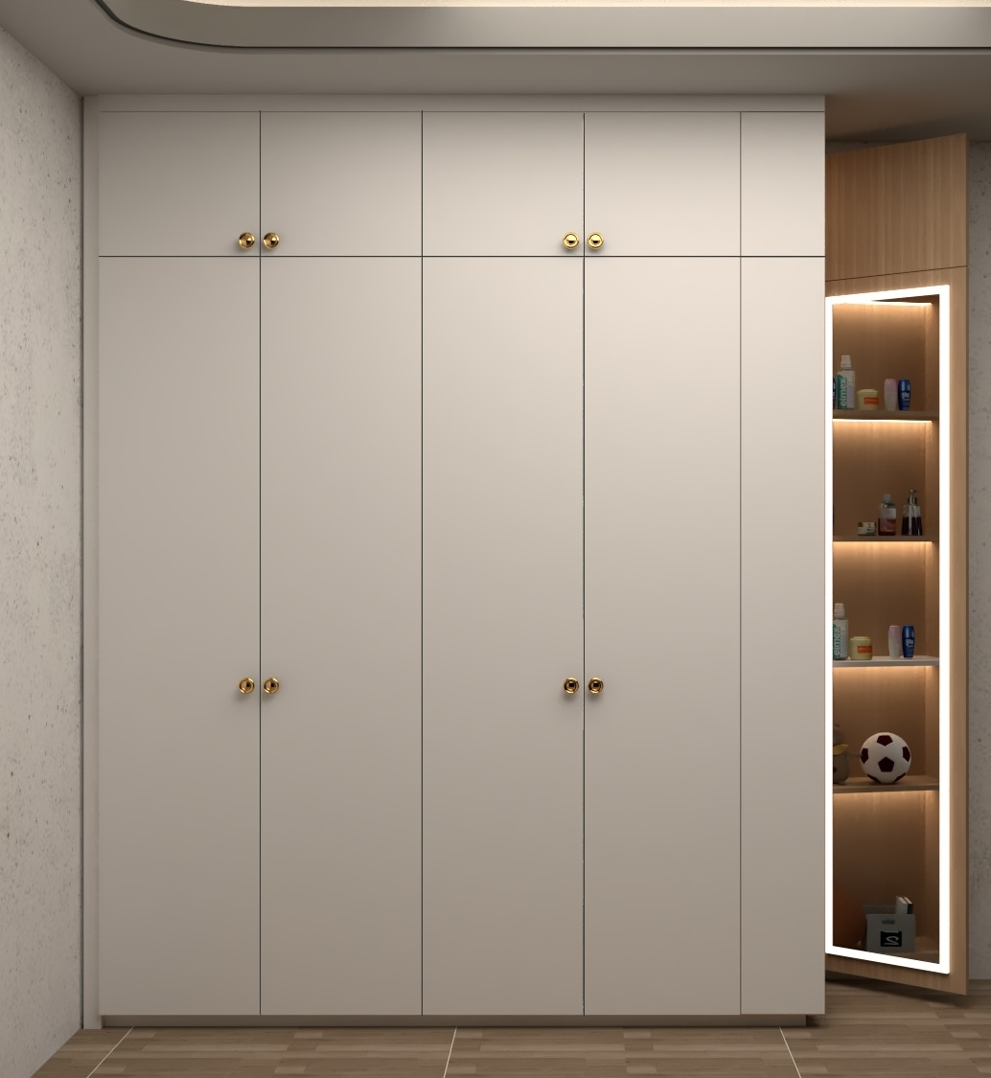
03
Pooja daksh

Slide 9
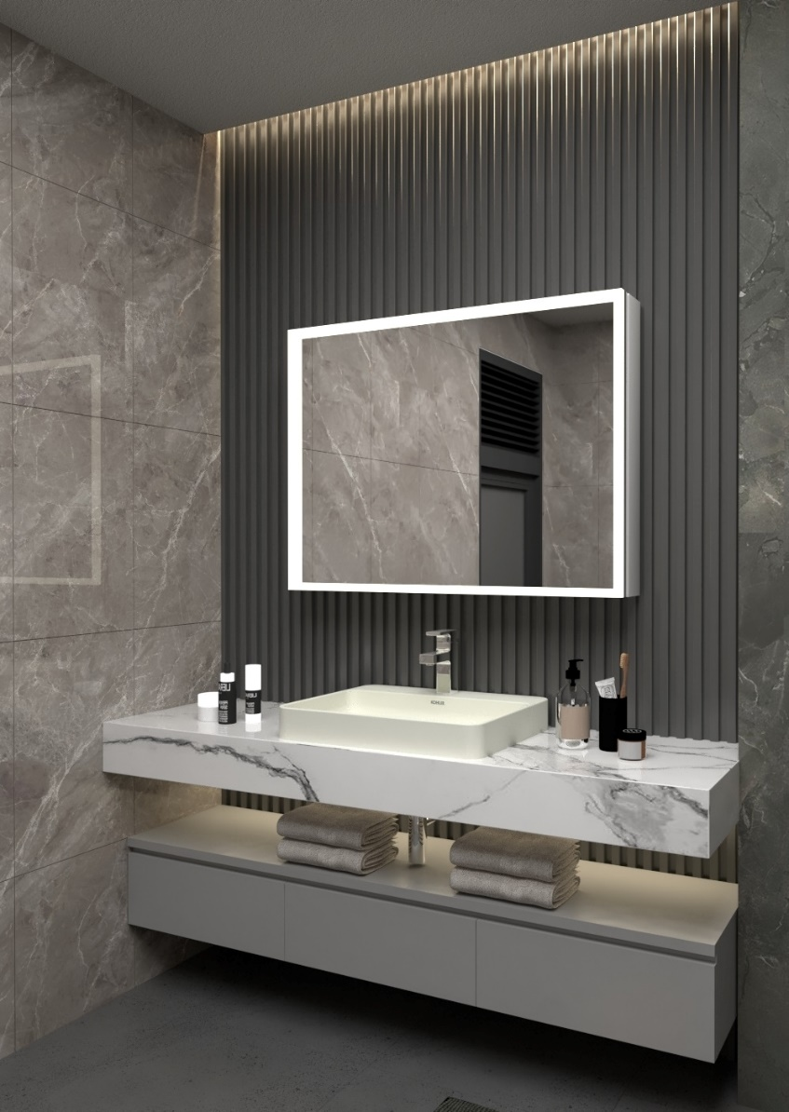

03
Pooja daksh

Slide 10
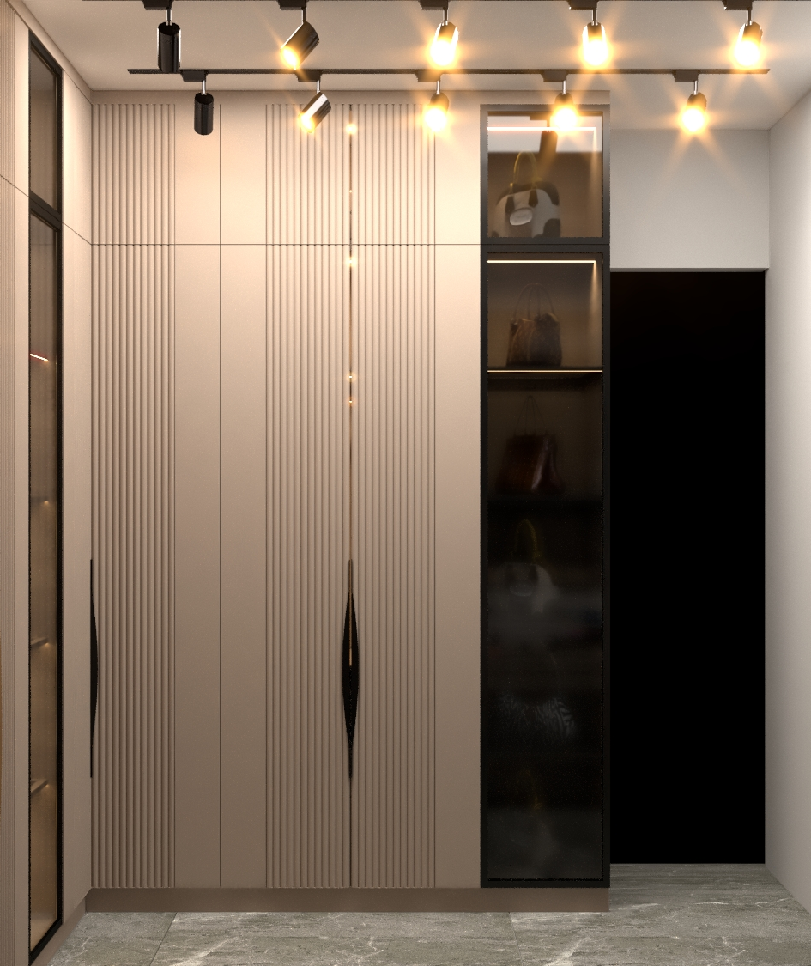
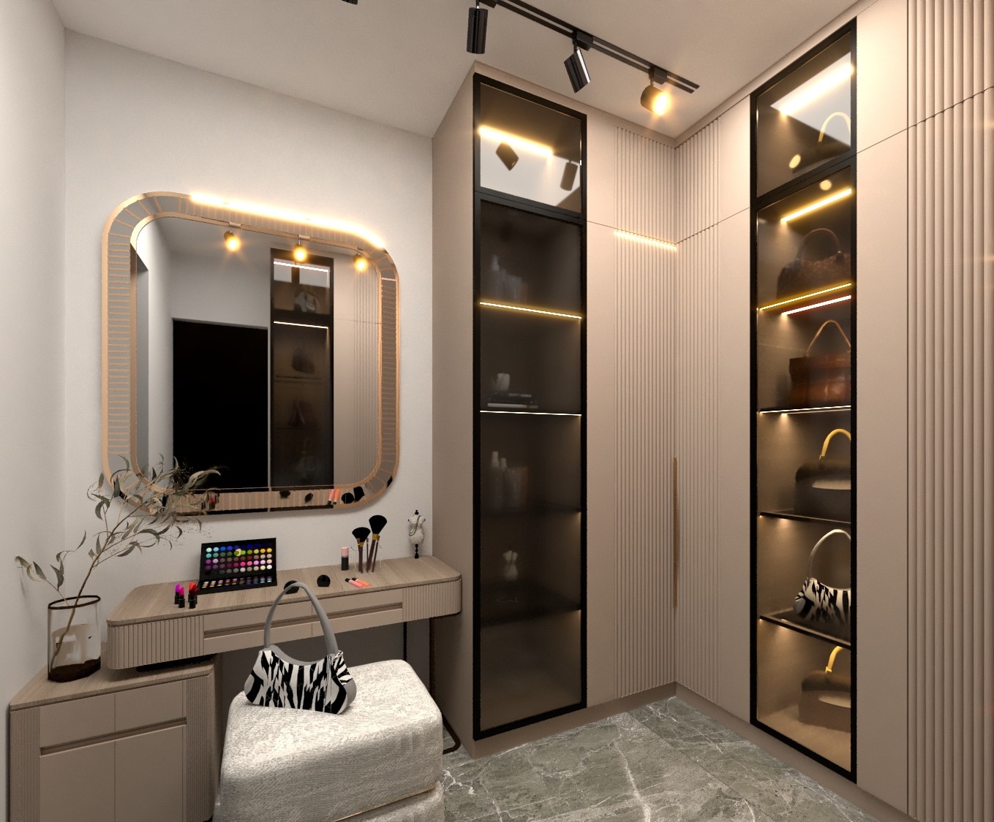
03
Pooja daksh

Slide 11

DENTAL CLINIC
03
sketchup
Pooja daksh

Slide 12
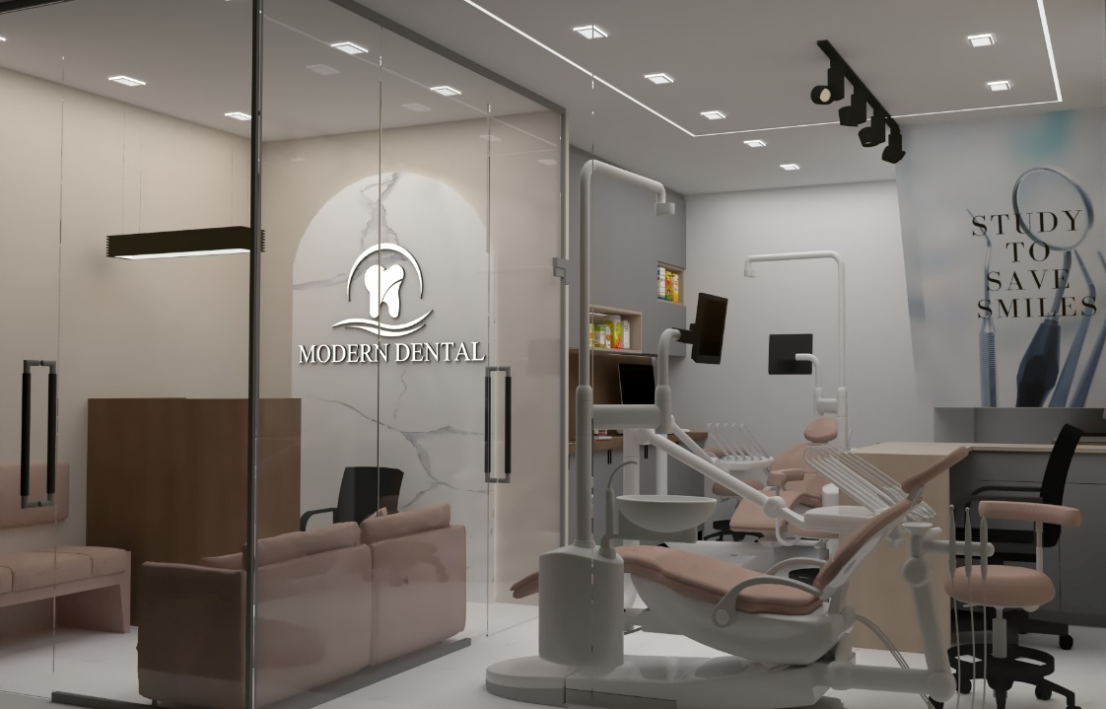
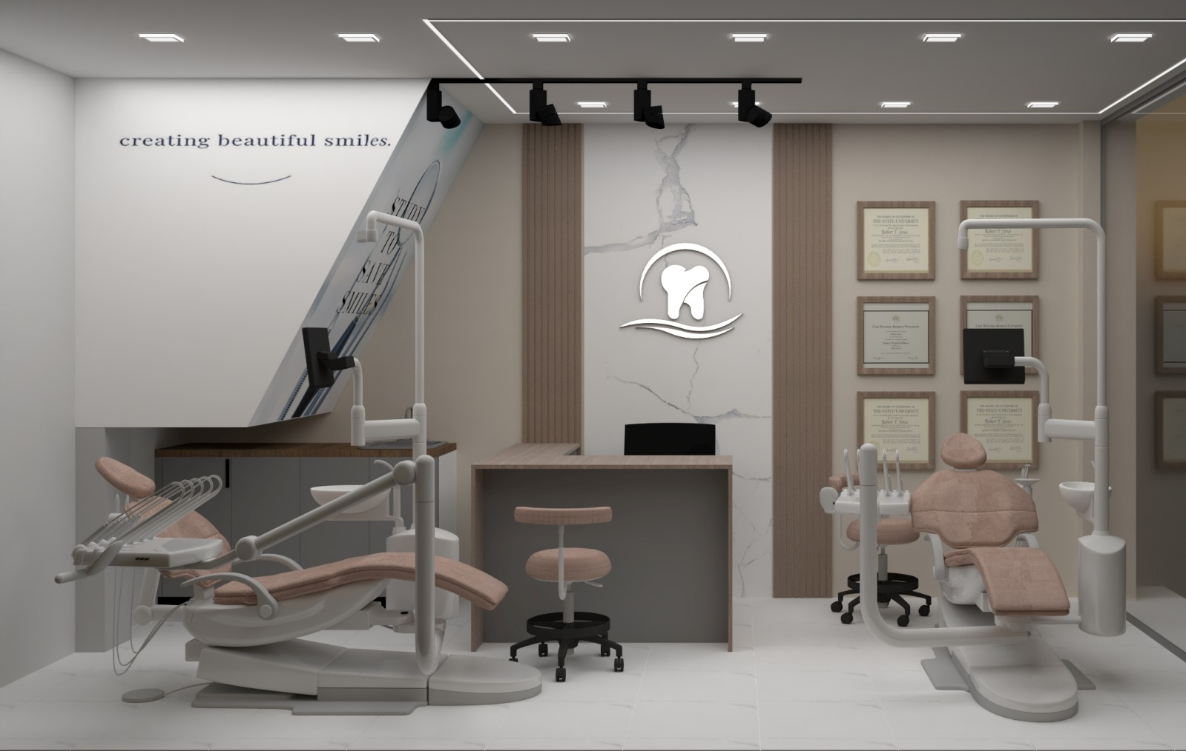
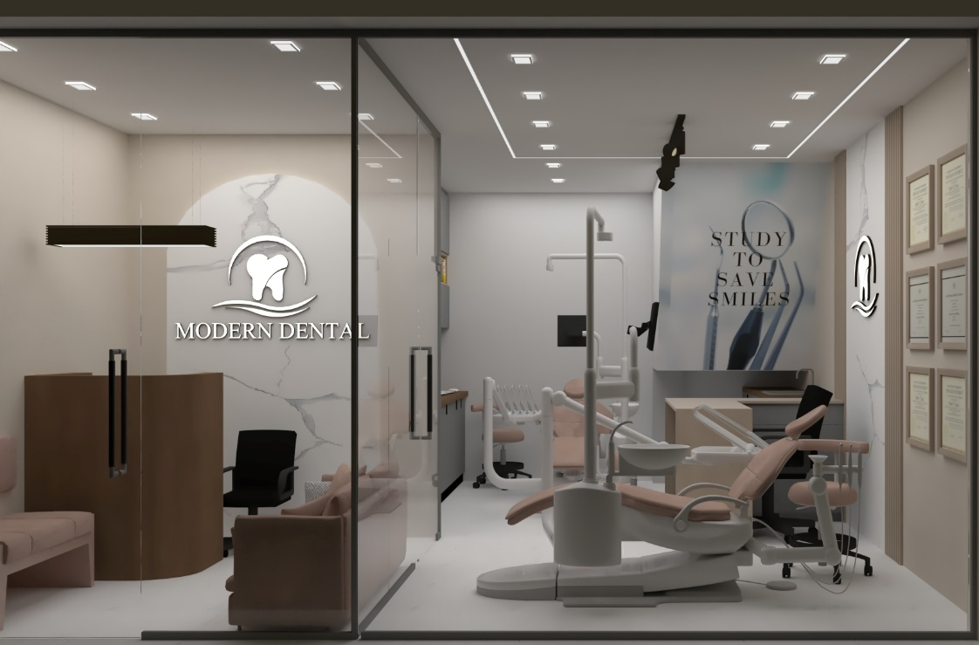
03
POOJA DAKSH

Slide 13
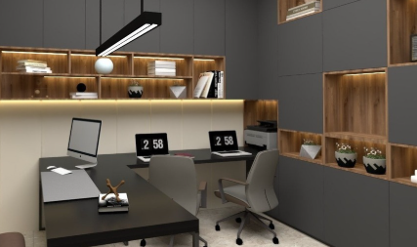
Study room
03
sketchup
Pooja daksh

Slide 14
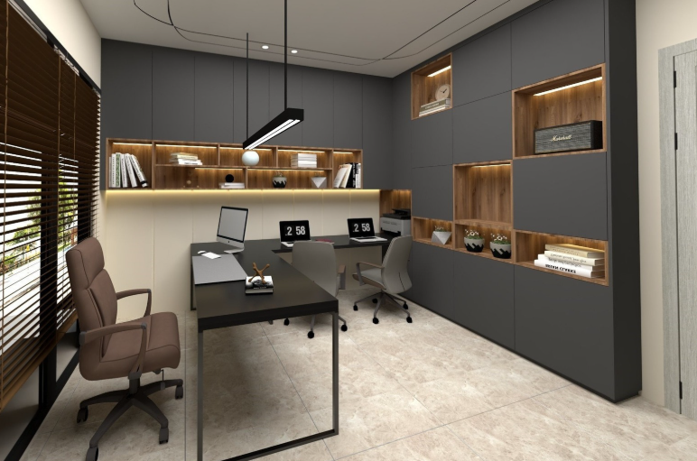
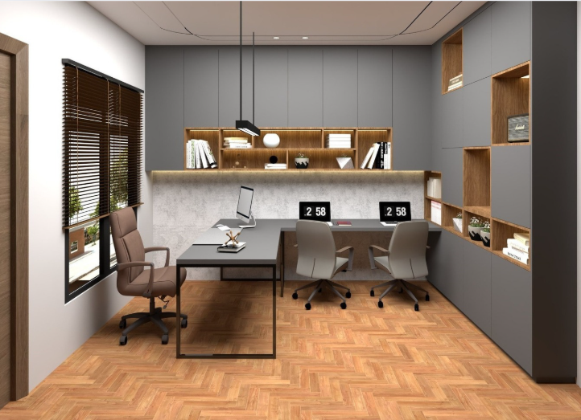
03
Pooja daksh

Slide 15
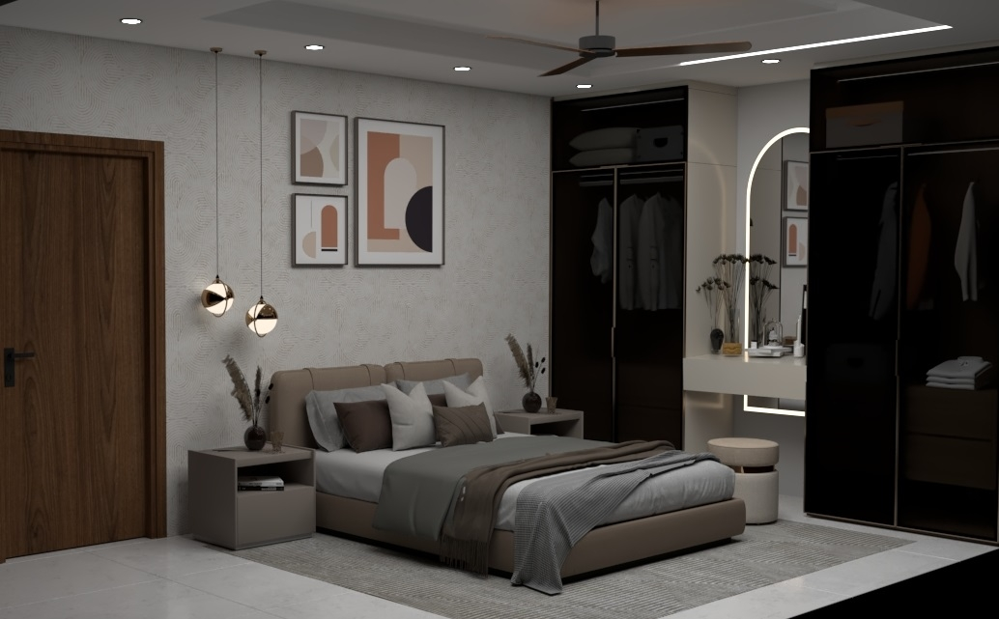
BEDROOM 3D
03
sketchup
POOJA DAKSH

Slide 16
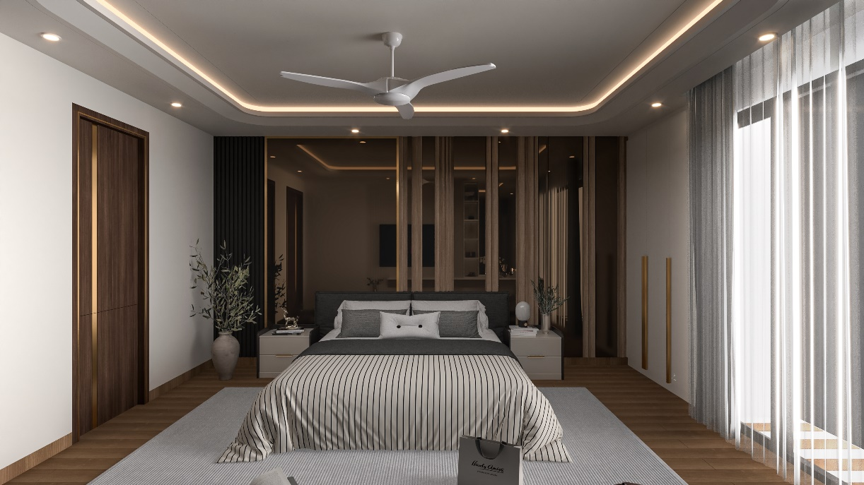
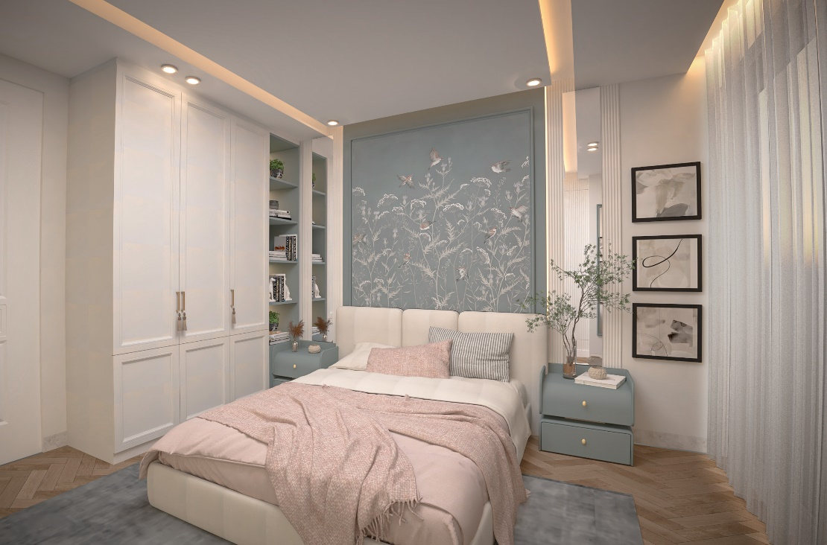
03
Pooja daksh

Slide 17
THANKYOU
03
Pooja daksh

